Slide 1

URConnected
Group members: Allan Wambold, Carter Brezinski, Salim Bakri
Milestone 2, Oct 23rd
https://github.com/ENSE-374
Notes:
Carter

Slide 2
What are we doing?
Notes:
Carter
Just a quick reminder, we are URConnected, the group that is working to build a functional forum and messaging service for the students at the University of Regina. We will be creating a web application that will allow students to get involved with other students with similar interests and classes.

Slide 3
Diagrams, MVC, etc.
Notes:
MVC - Photo from Github
Use Case diagram
DFD diagram

Slide 4
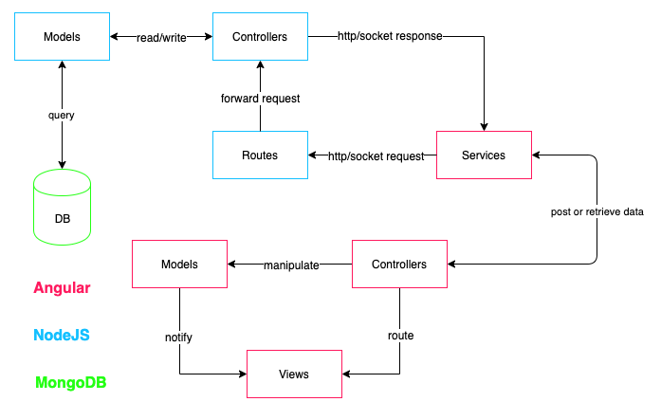
MVC Prototype
Notes:
Salim
Display of our MVC diagram and the communication going on between the web application, server-side java code, and the database.

Slide 5
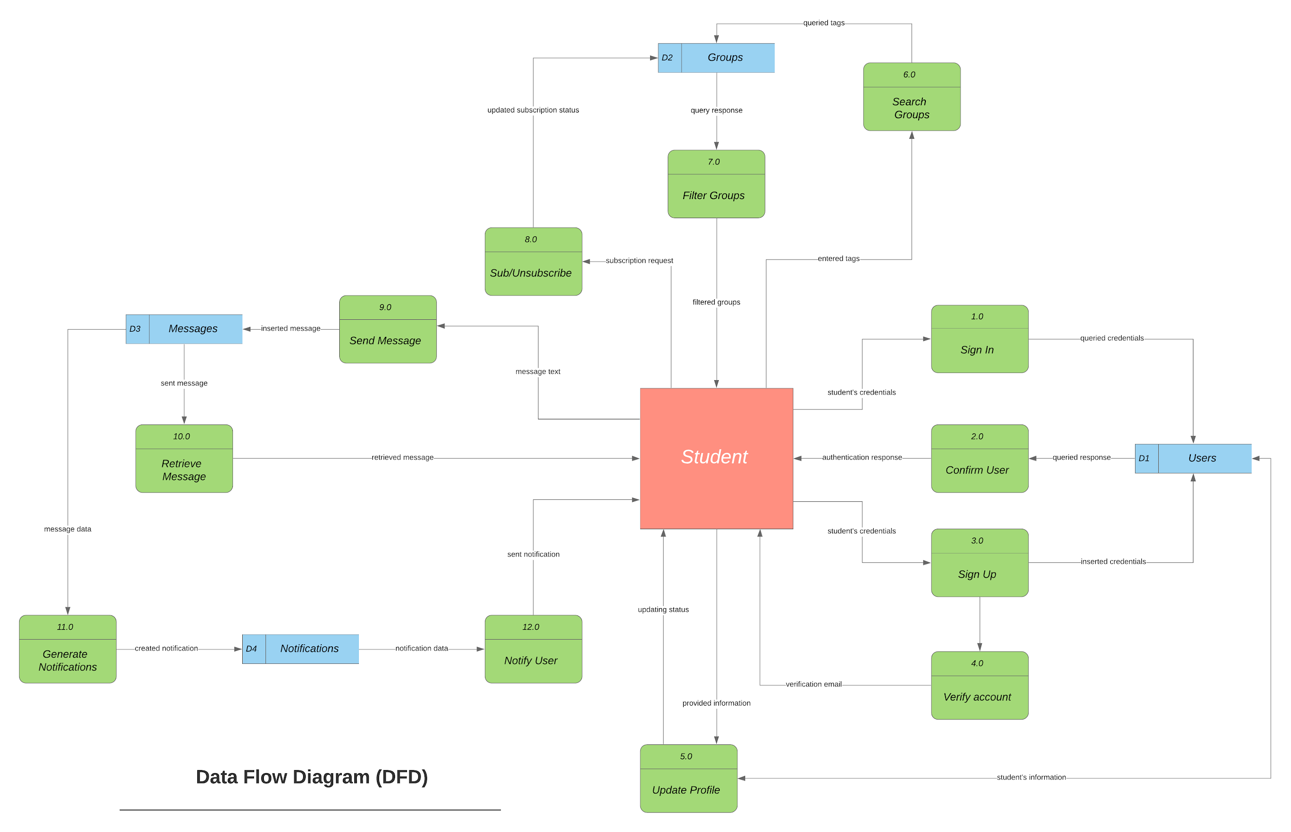
Data Flow Diagram
Notes:
Salim
Display of our data flow diagram

Slide 6
UML for MVP-1, domain driven design.
How are we applying domain driven design?
Notes:
Carter
Domain-driven design (DDD) is an approach to software development for complex needs by connecting the implementation to an evolving model.
We are applying domain driven design so we as a group can understand the complexity of the design we will be building. We have built many diagrams to map out the tasks, events, and communication and correlation that goes on between the user, the view, model, and the database.

Slide 7
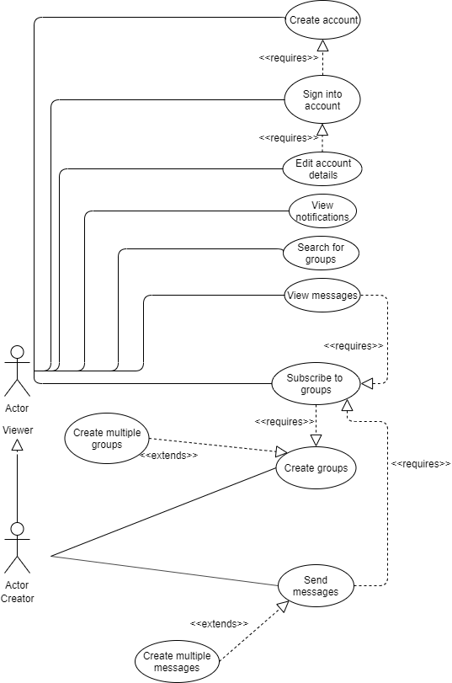
Use Case Diagramming
Notes:
Allan
A display of our use-case diagram for our project.

Slide 8
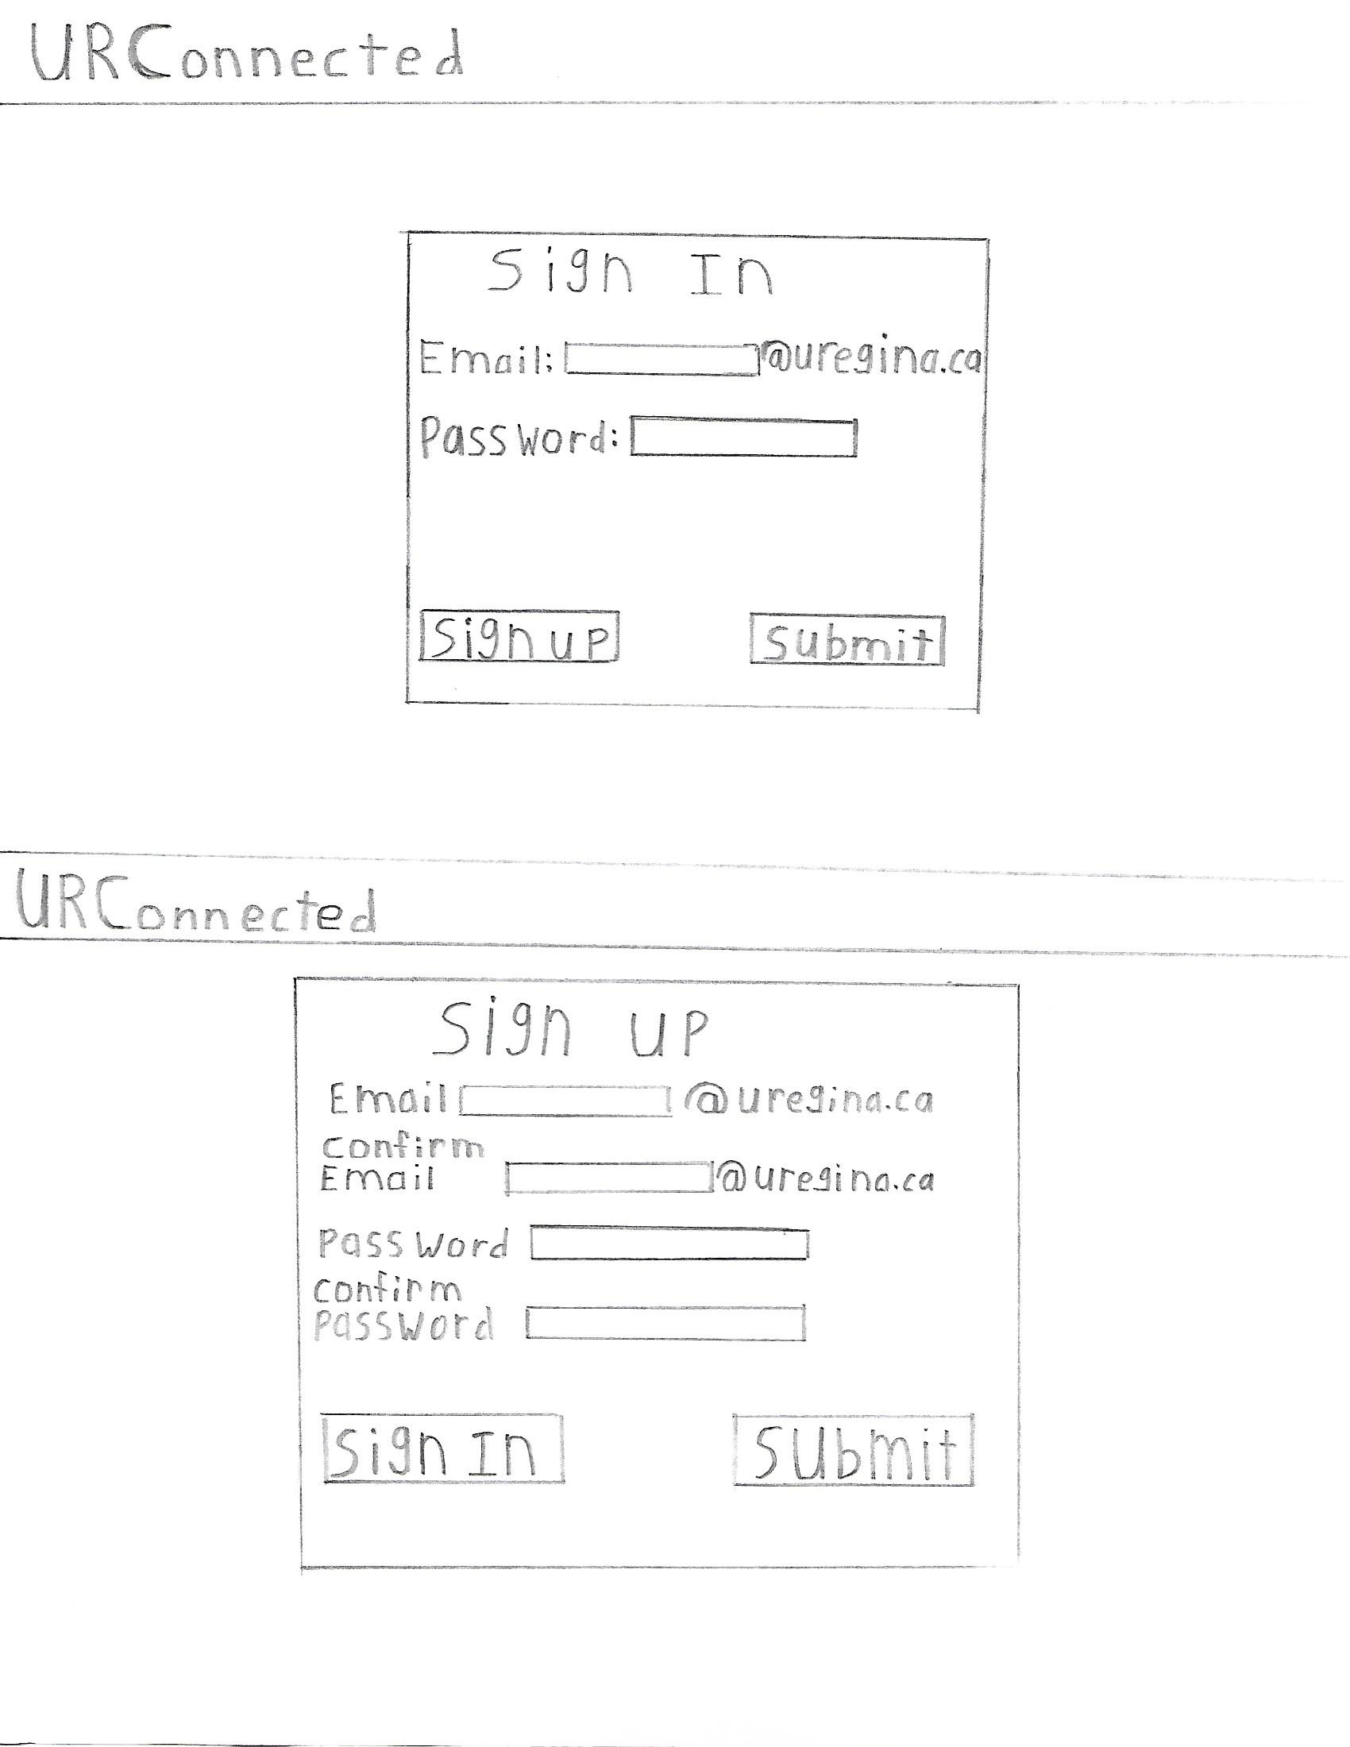
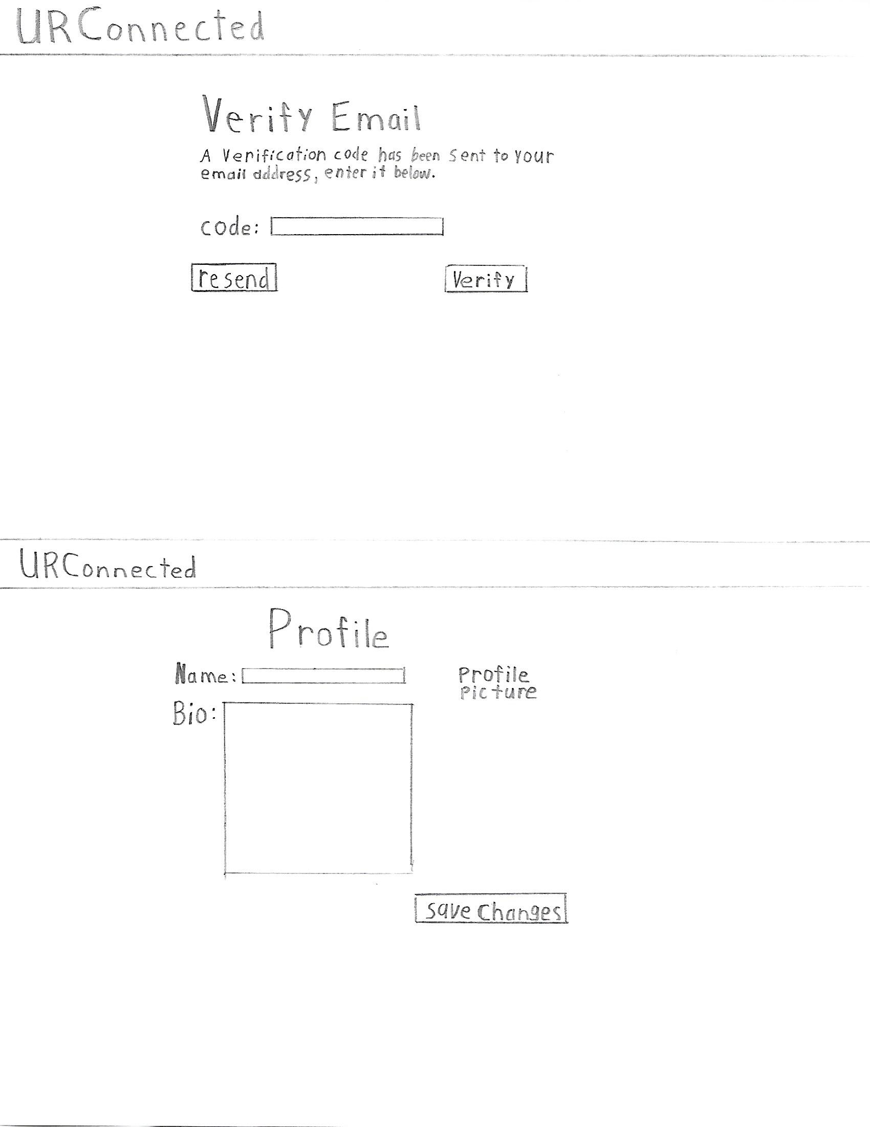
Lo-fi prototype
Notes:
Allan
Display of our Lo-Fidelity prototype, that Allan took the time to draw out for us as a visual of what we want our project to look like.

Slide 9
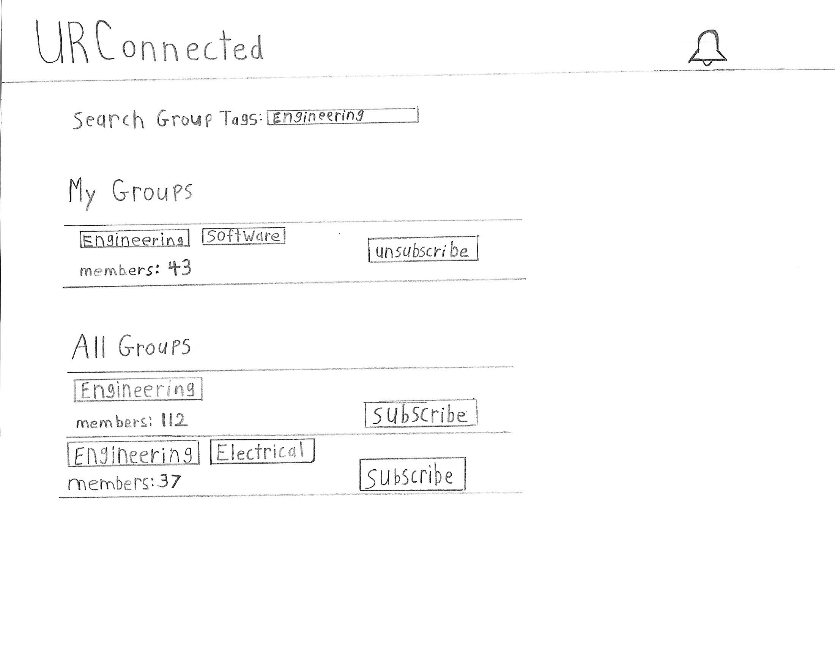
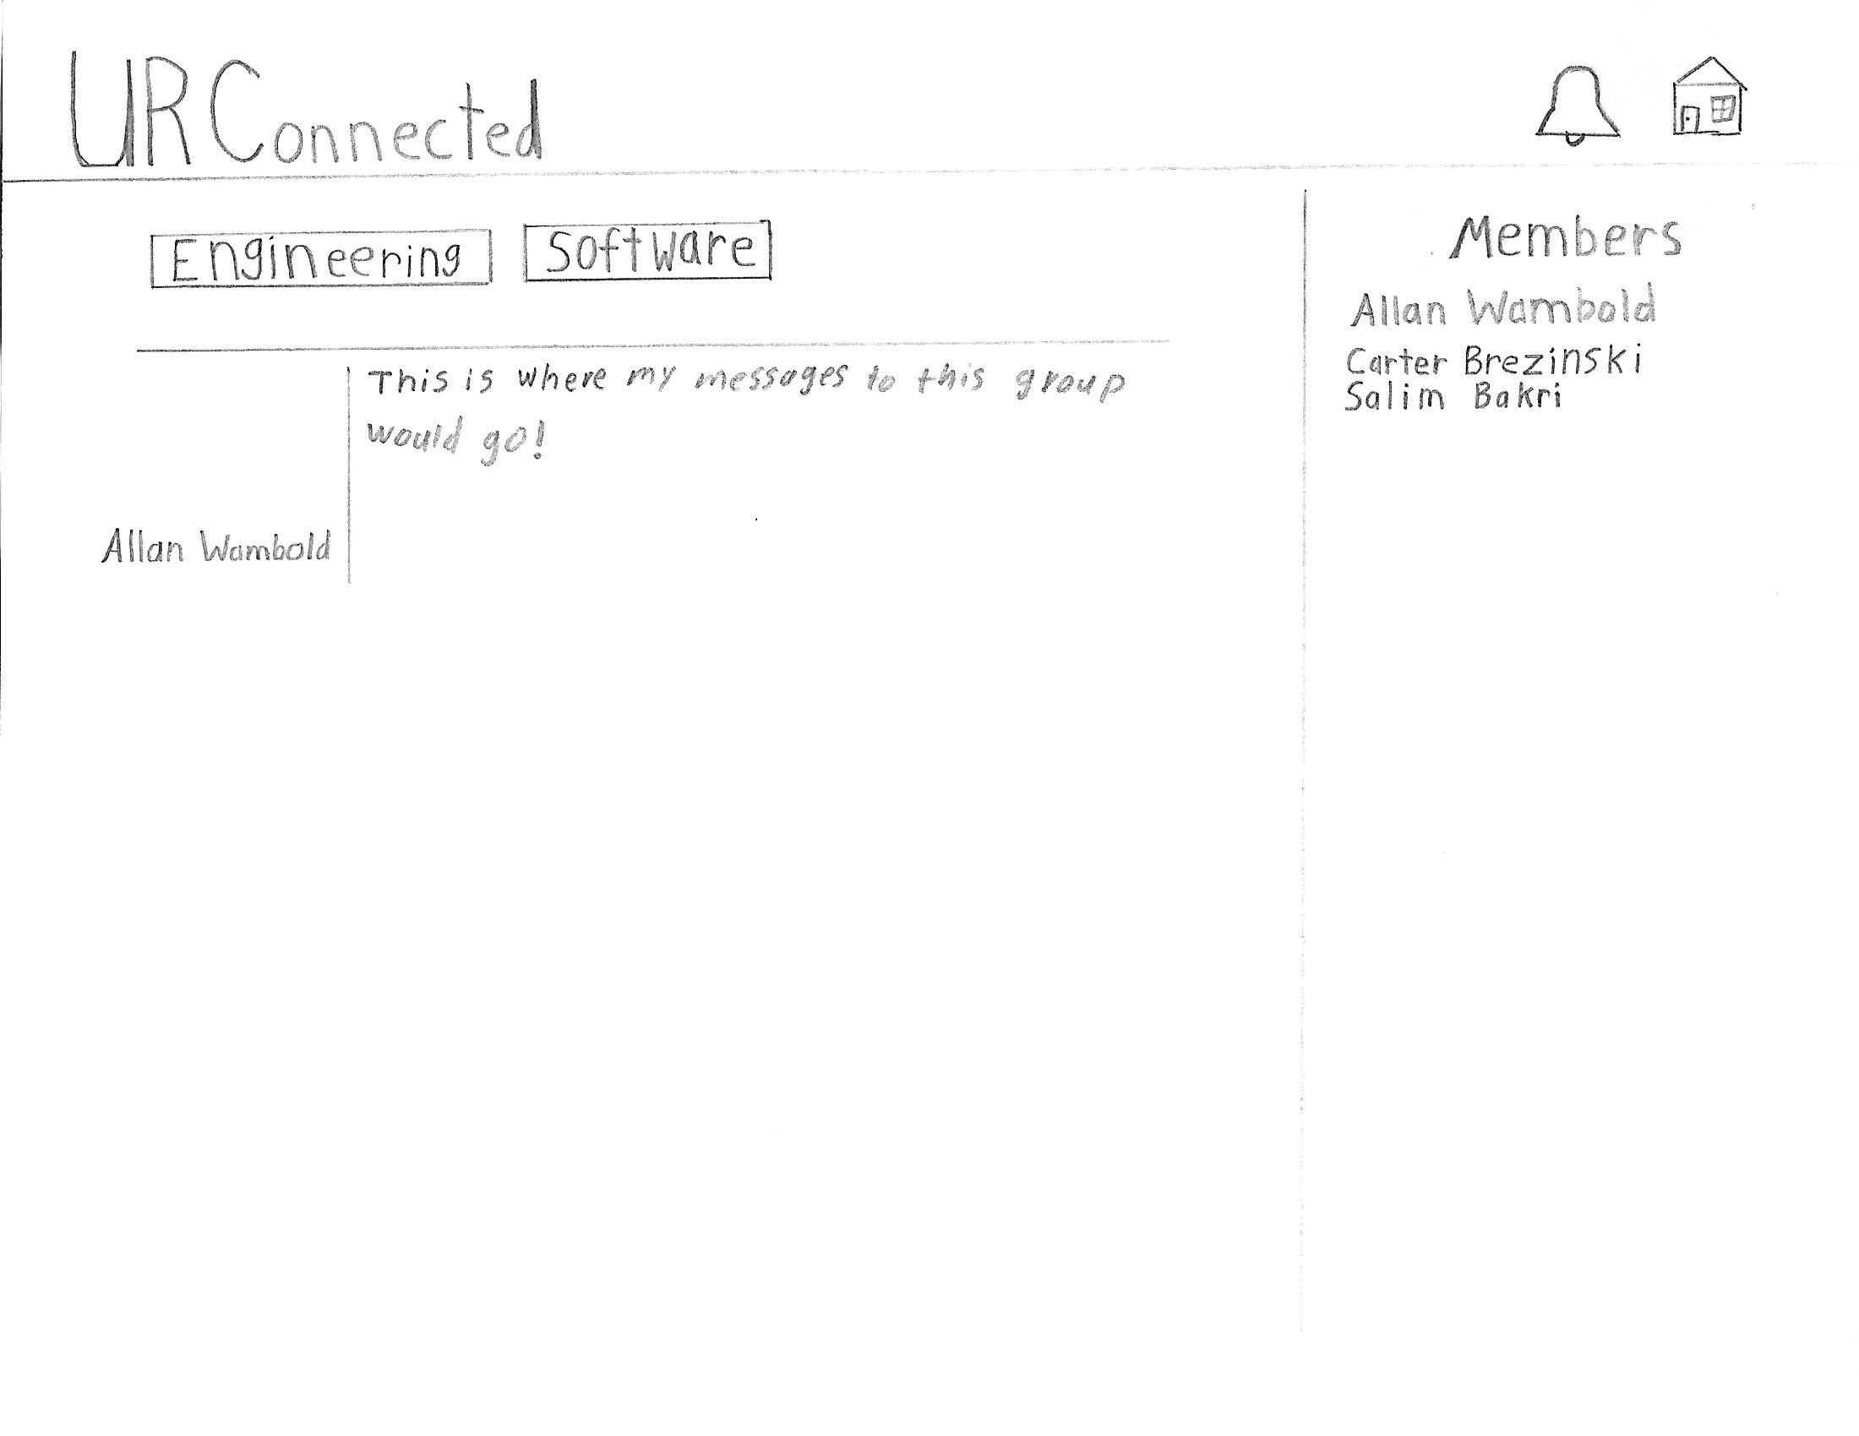
Lo-fi prototype
Notes:
Allan
Display of our Lo-Fidelity prototype, that Allan took the time to draw out for us as a visual of what we want our project to look like.

Slide 10
GitHub & Kanban review
Updated Kanban (in GitHub)
Our updated file structure
Notes:
Salim
A current change to our GitHub is the fact that we have chosen Salim as the Scrum Master of the group, and that all decisions for the group project will be finalized by him.
We also chose to set our GitHub up to be an organization rather than just a project.
We’ve updated the user stories and made them more feasible for the development stage.
We also created various issues in correspondence with this current milestone, this would include the creation of all our diagrams, changing the Functional Requirements Document, and the uploading of this powerpoint.

Slide 11
https://github.com/wambolda/URConnected/projects/1
Kanban in Github
Notes:
Salim

Slide 12
Team Functional Requirements Document
What has changed?
Notes:
Carter
In our FRD, we added the following: Methodology and explanation behind the diagrams we chose, as well as including said diagrams, additionally the Functional requirements for the project and each component and interaction, and the nonfunctional requirements catered more towards the user were all added.

Slide 13
Team’s focus for MVP-1
Envisioned barriers
Notes:
Carter
Our focus for MVP-1 is the following:
Learning how these languages will communicate with one another may be a future difficulty for us. Additionally, all of us working individually over GitHub may be an issue.

Slide 14
Group Reflection:
How did you feel about this milestone? What did you like about it? What did you dislike?
What did you learn about yourself as you collaborated and worked through this milestone?
How will you use what you have learned going forward?
What “stuff & things” related to this milestone would you want help with?
Notes:
Carter
Our feelings for this milestone are relatively the same, it was nice to get our ideas on paper and in diagrams so we can visualize what we want.
We took the time to figure out everyone’s strengths and weaknesses.
We’ve divided the roles based on our software skills and our familiarity with the languages we’re going to be using.
User feedback is greatly appreciated, we would love to hear your ideas on how we can improve or optimize this project.

Slide 15

Questions?
Notes:
Carter

